Slide 1
AUB Advisor
Dina Masri, Louay DIMASSI, MOHAMAD FAKIH, JAD ABI NADER

Slide 2
Current Problem
Students are enrolling for classes and paying thousands of dollars for courses that
Won’t be counted towards their degree
Are mistakenly thought to constitute a General Education Requirement
Are thought to count towards a certain GER but in fact count towards another
Result in a delay in their date of graduation

Slide 3
Motivation
Help guide students during their stay at AUB by:
Implementing a system that carries all relevant information a student may need to achieve their desired degree and/or goals
Make this system personal

Slide 4
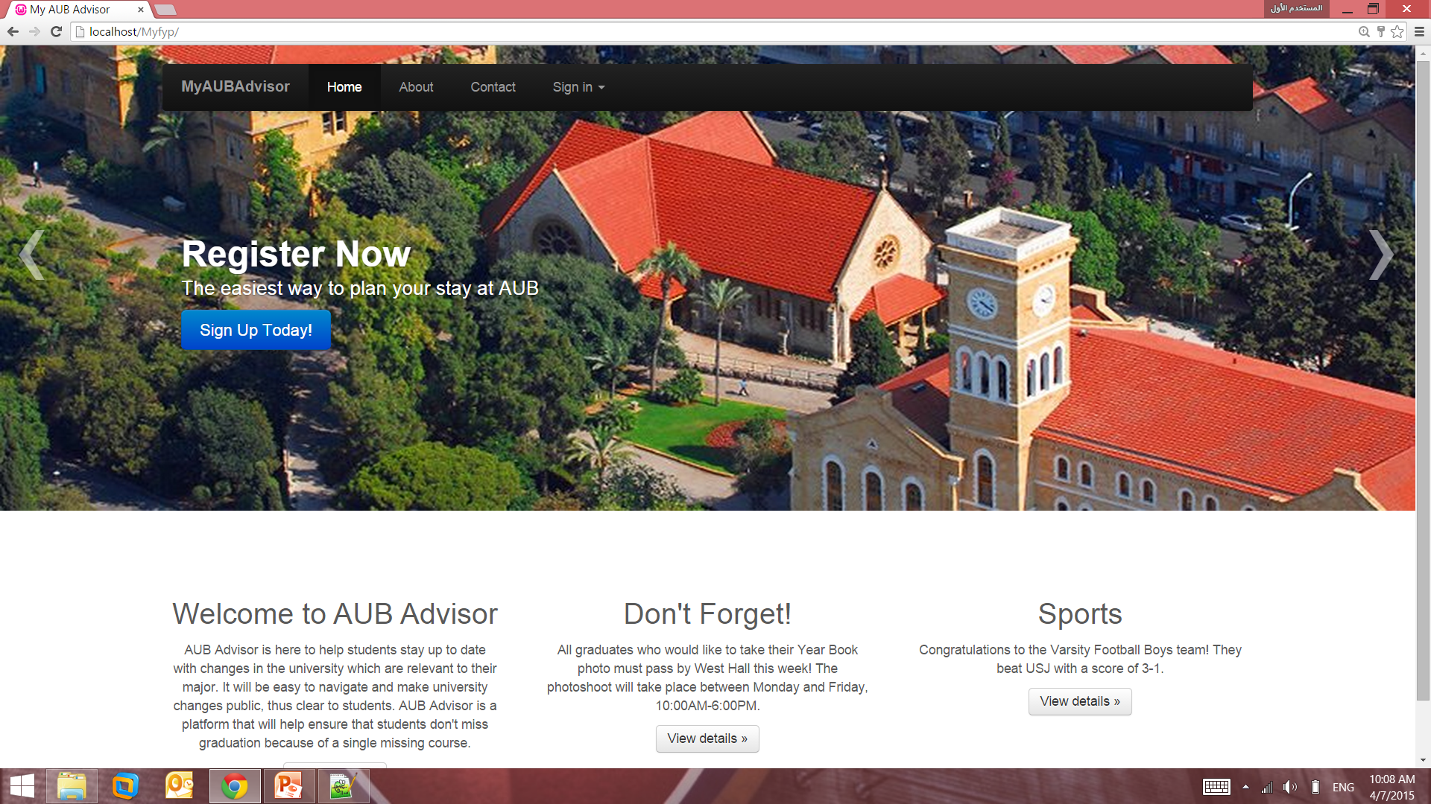
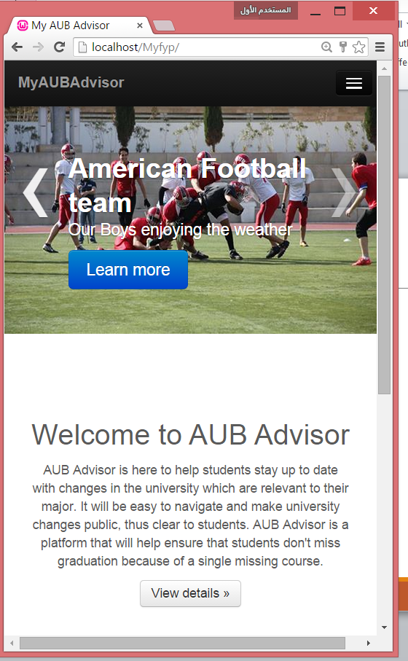
Our Solution

Slide 5
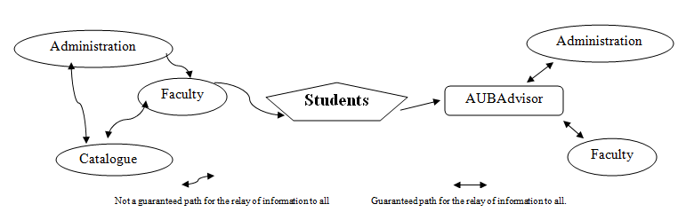
Our Solution

Slide 6
Features
Mobile and Desktop compatible
Personal Profile
Administrator modifiable
User friendly

Slide 7
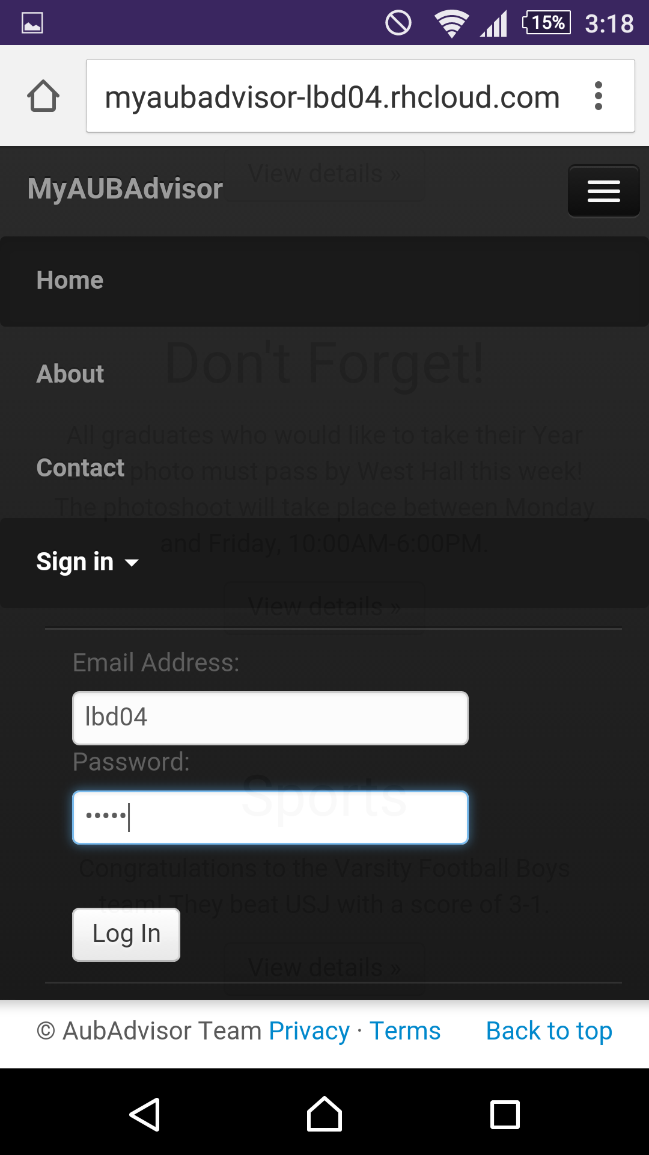
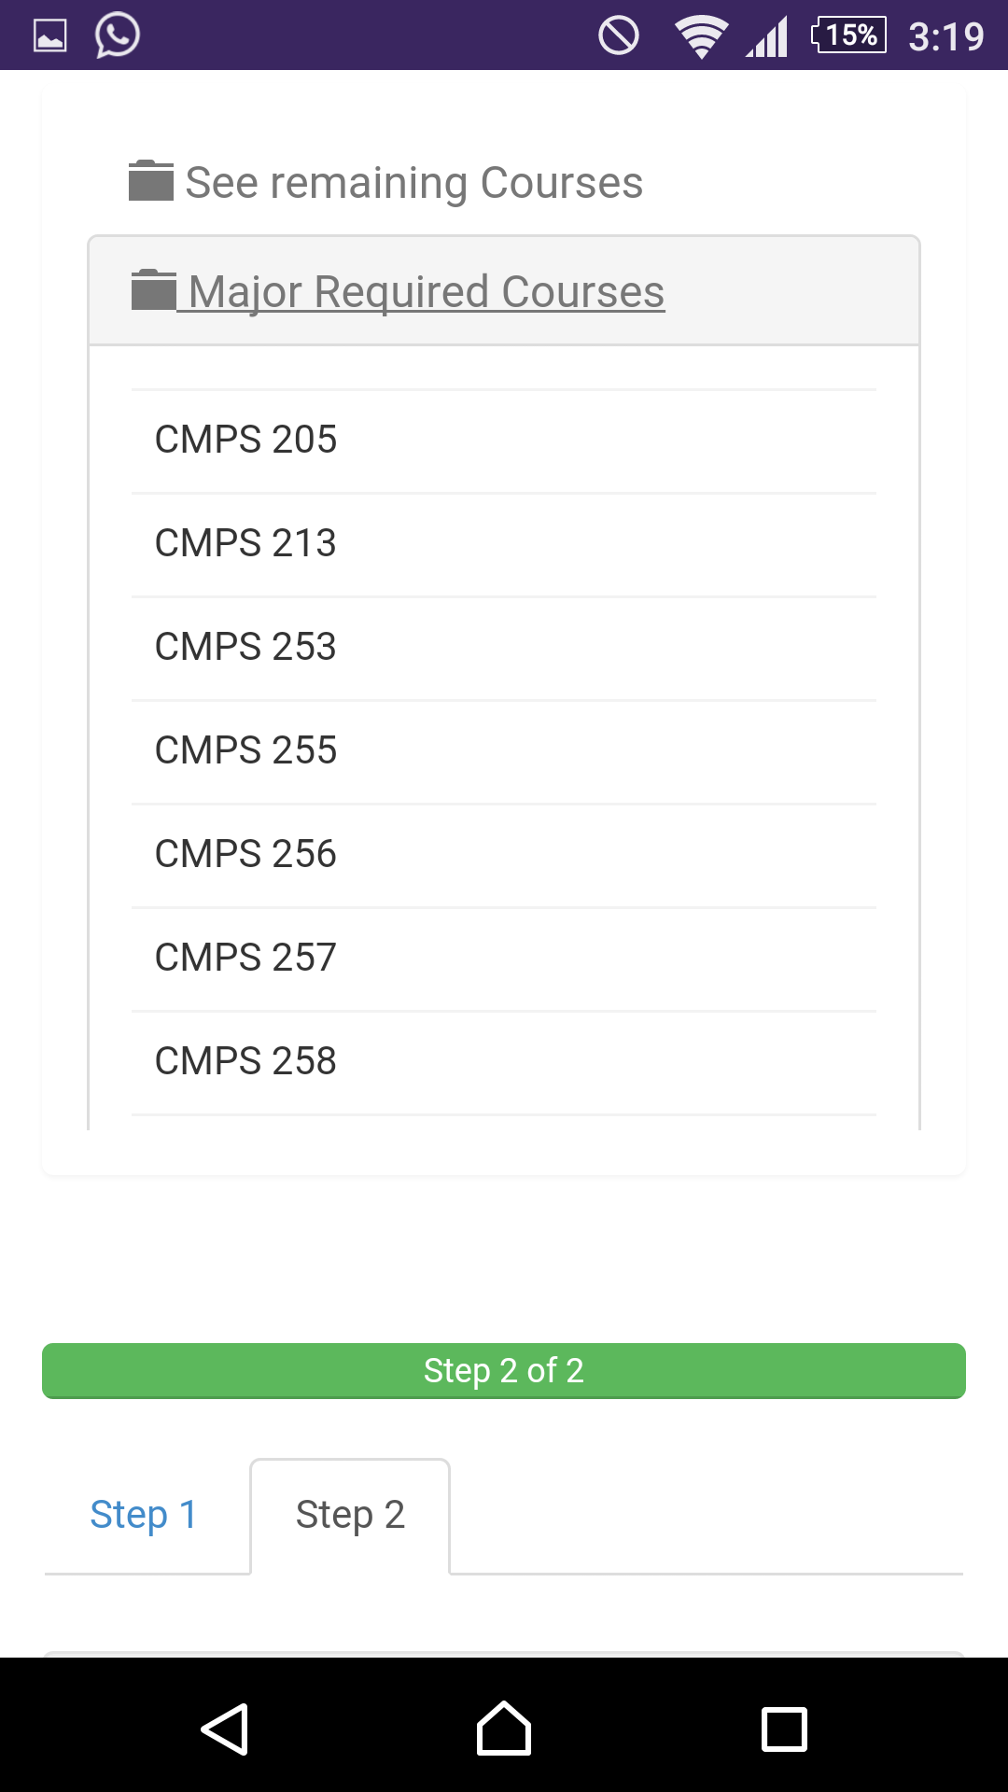
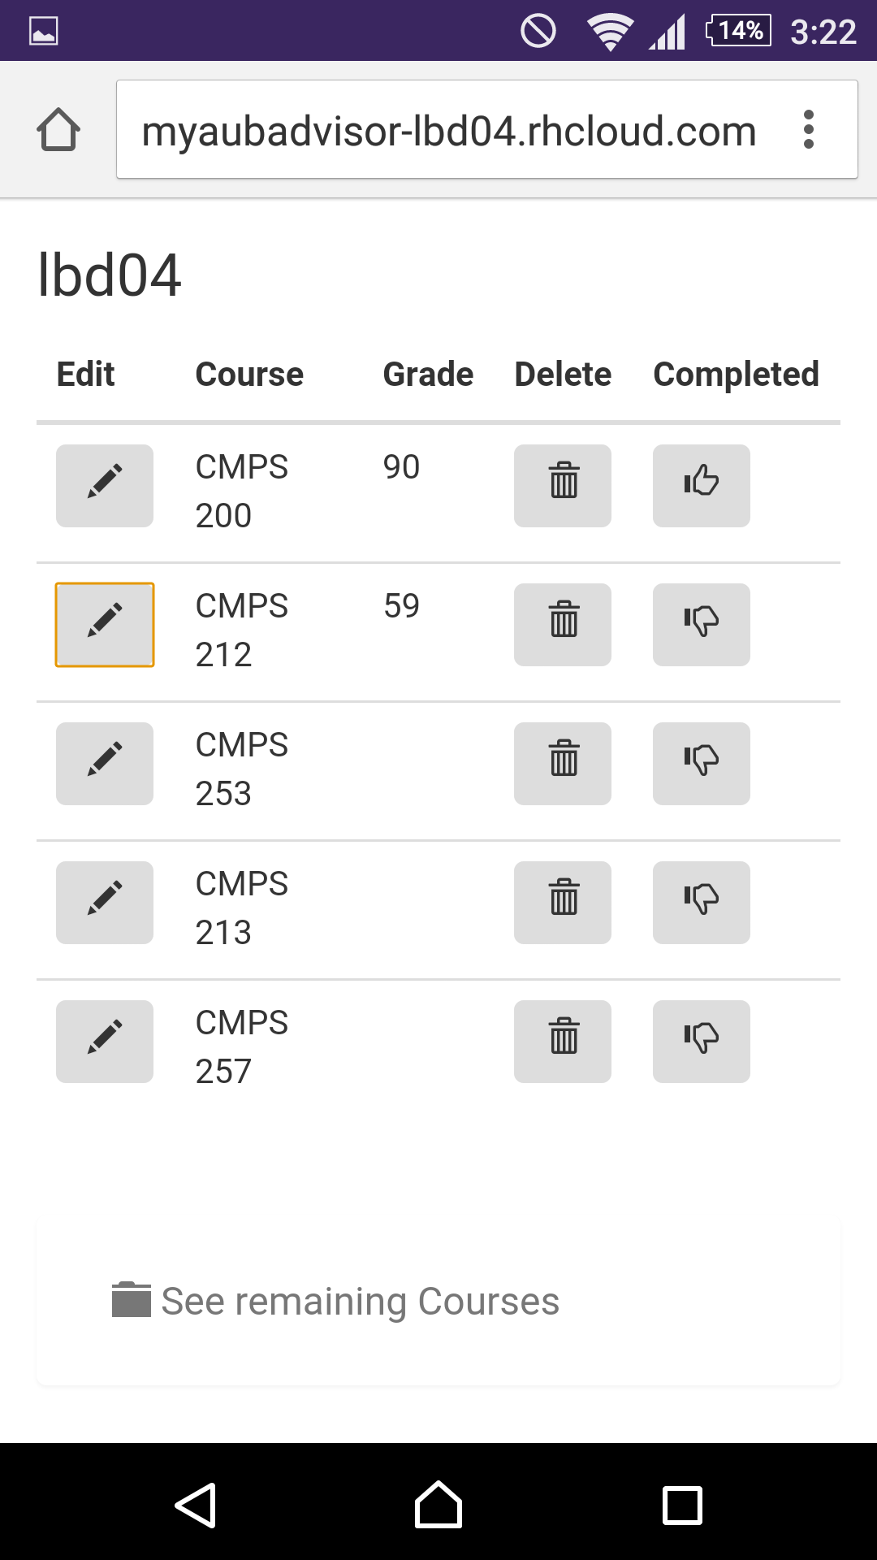
Personal Profile

Slide 8
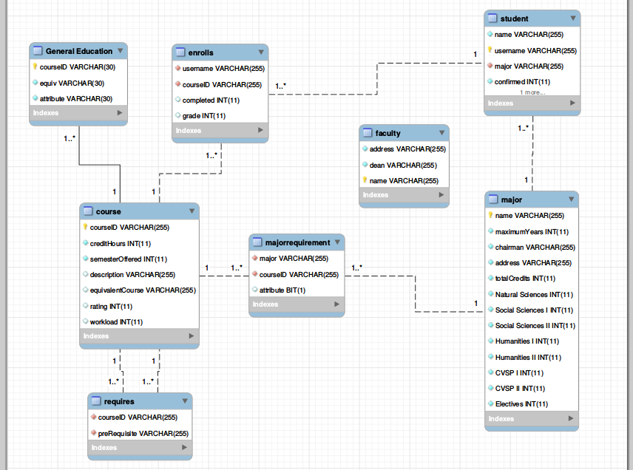
Database UML

Slide 9
Database Considerations
Course fields:
Semester(s) it is offered (integer)
Number of Credits
GER attribute
Major/Elective attribute
Equivalent course available
Prerequisites and co-requisits

Slide 10
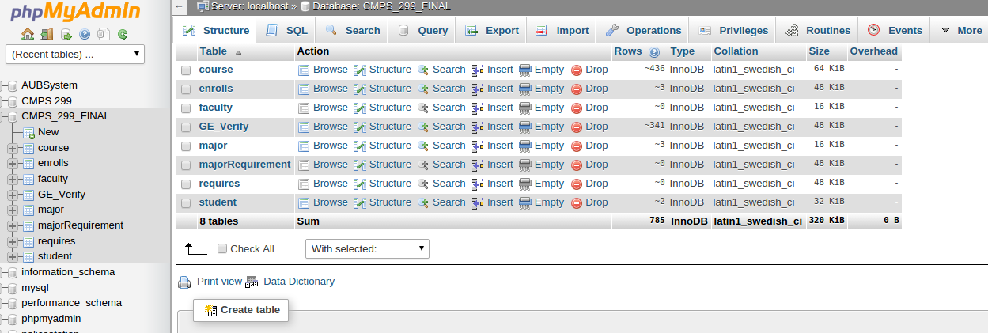
AUB Advisor Database
Notes:
Show demo after this

Slide 11
Tools and Difficulties
Tools:
JavaScript, PHP
AJAX, Angular, Bootstrap
MySQL
Difficulties:
Angular manipulation
Database implementation (No consistent pattern between majors, many exceptions)

Slide 12
Future Employment Limitations
The success of the application depends on how reliable it is:
Faculty and Administration notifying all changes
Students updating their profiles

Slide 13
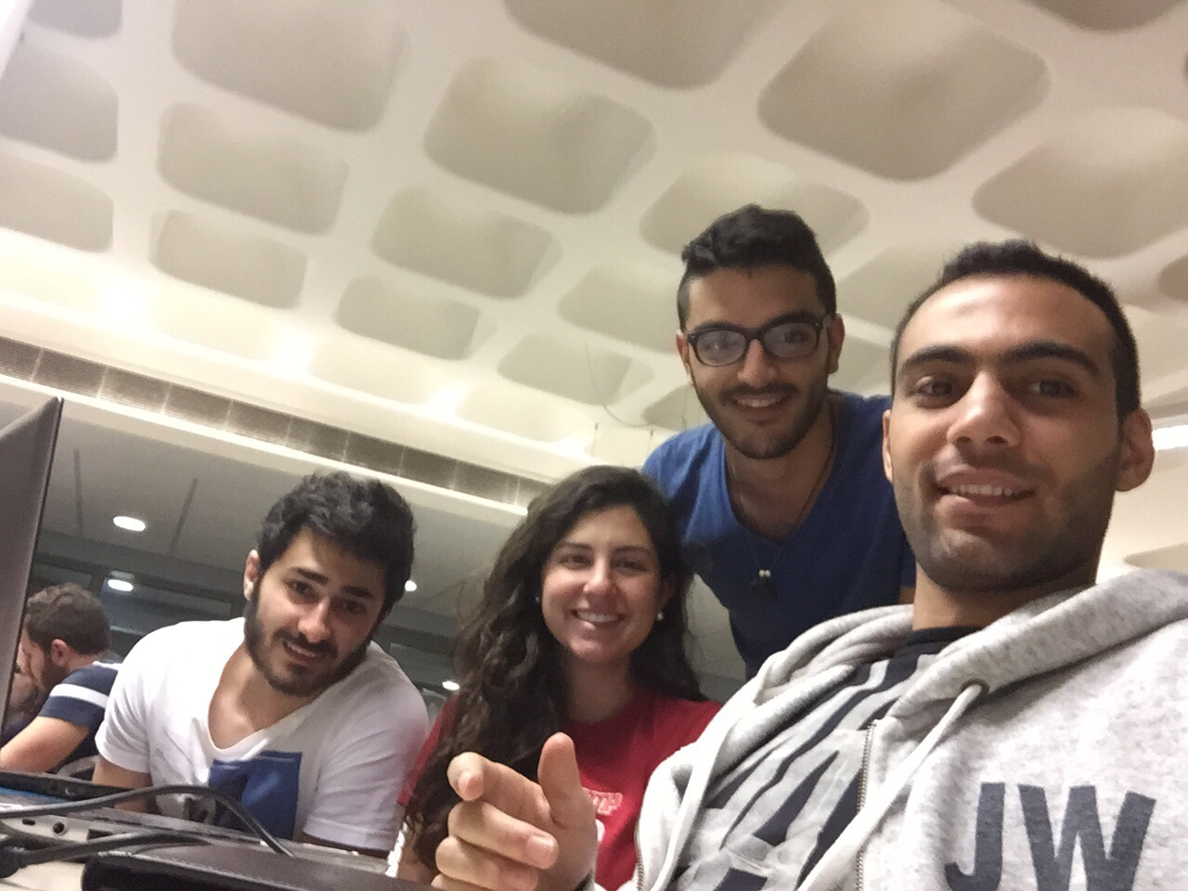
Thank you for listening!

